Slide 1
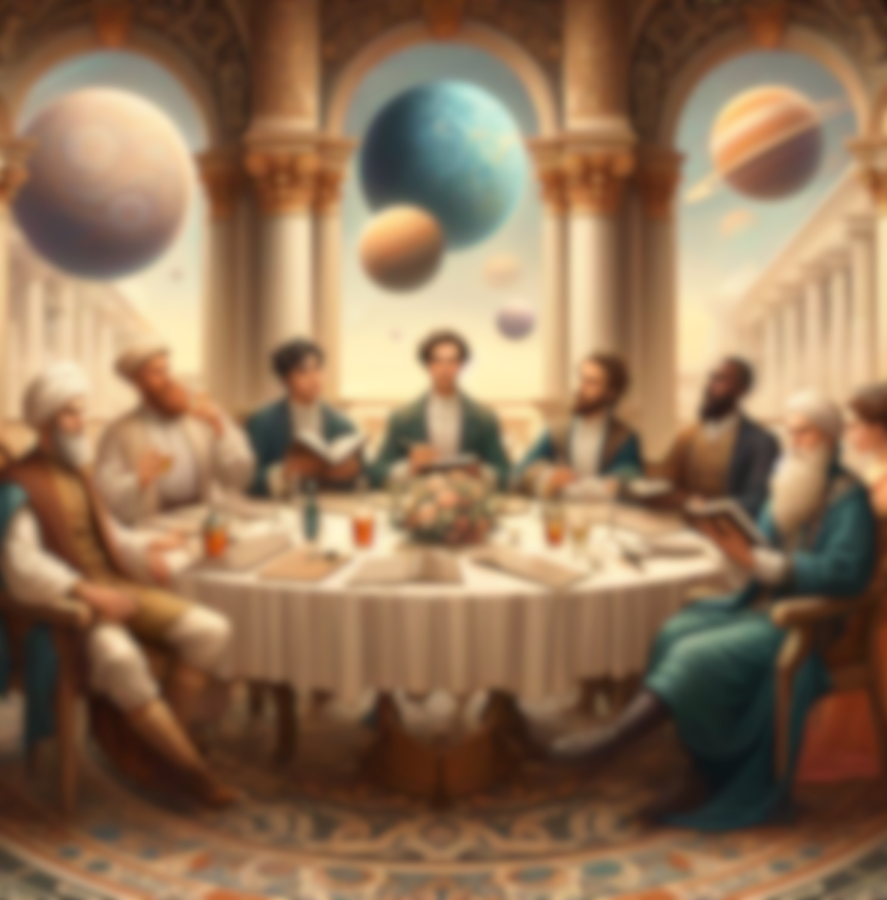
Poetica Harmonia
Purpose
An app to build a community of poets from different backgrounds and areas to purely immerse in the world of poems.
Gurpreet Singh
21131818

Slide 2
Background
WHAT IS POETRY
Piece of literature which draws out the creative/emotional response of the reader through an arrangement of words constituted of specific meanings, and rhythms (Poetry, 2024).
THE ART OF POETRY
Poetry is an art, therefore cannot be examined by the metrics of science, therefore scrutinising it can be meticulous work (Jung, C.G., 1966). Petry engages the creative part of the mind which allows illogical, unique responses to be considered for situation. As a thought-provoking exercise it is widely liked throughout the centuries and regions of the world.

Slide 3
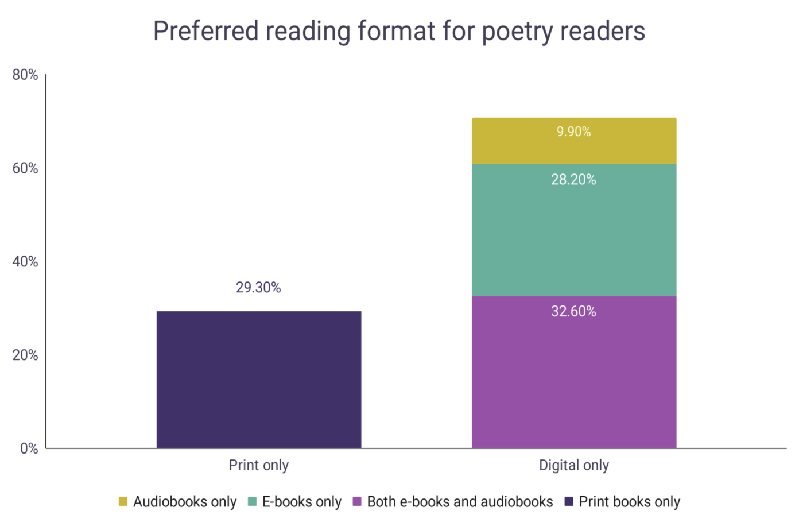
Background
POETRY COMMUNITY
Statistics used are of US over decades, even though there has been a decline in the community from the late 1900s. There is a stagnant rate in the past few years, from 2017 where there were 11.7 % adult readers whereas in 2012 only 6.7% a 75% increase. (Curcic, 2023)
Moreover, from surveys it is seen that Americans from 18-34 are the only readers of poetry and a few in the elder groups (Curcic, 2023).
Finally, Figure 1 shows that e-books are the most used way to read poetry (28.20% - 32.60%); even though prints are still a big proportion at 29.3% (Curcic, 2023).
Figure 1- visualization of different formats of poetry reading (Curcic, 2023).

Slide 4
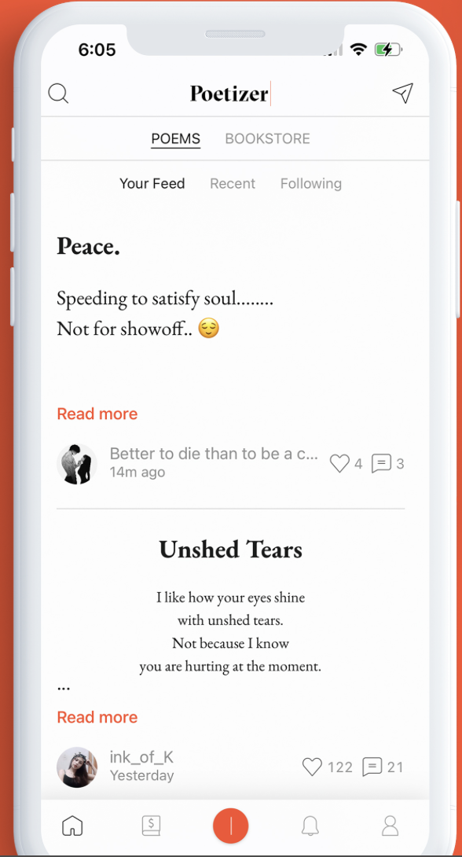
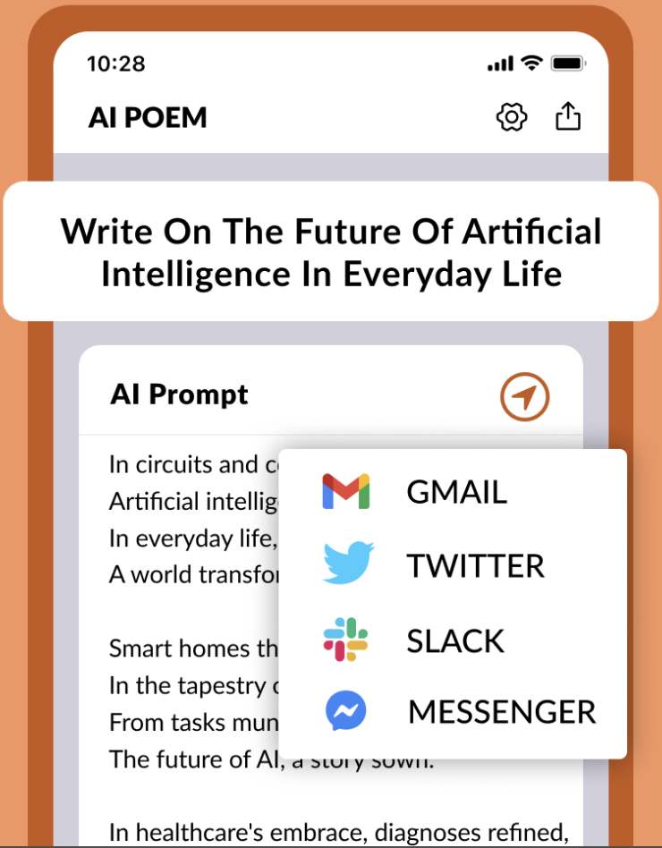
Similar applications I
Description
Allows users to write and publish poems add-free. Has a forum of published poems. Allows to assign favorites and explore the bookstore. Has a free trial.
Paid features.
Description
Users can use AI prompts to write different types of poems and other scripts.
Poetizer: Read & Write poetry
AI Poem Generator- Write a poem
Stars: 3.3
Downloads: 500K+:
Downloads: 10K+

Slide 5
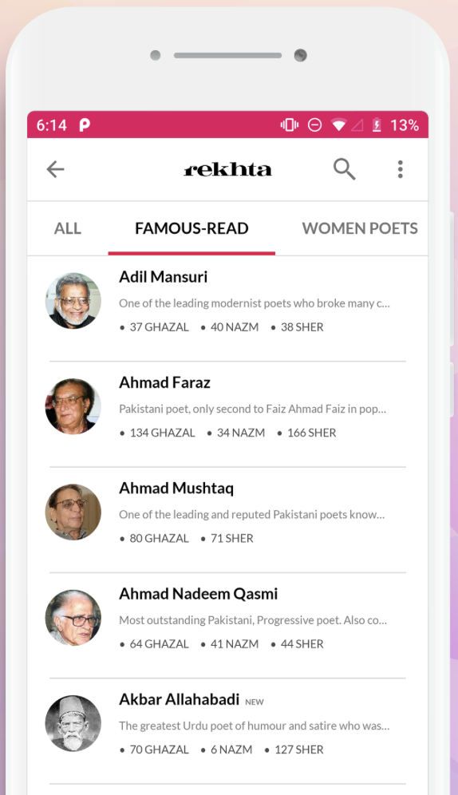
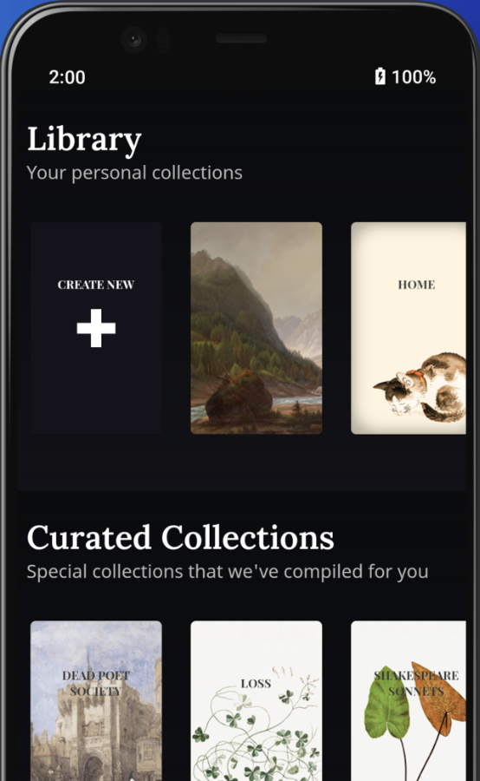
Similar applications II
Description
Originated from a website, has the largest collection of Urdu poetry and literature. It has audio, images and videos as well as literature. Allows the user to brows through them.
Updated regularly.
Description
Main features to send daily poems personalized to user which can be customized in settings page.
Also, the user can, from the existing libraries, create a personalized library and search tools.
Contains premium features (main: audible).
Urdu Shayari & poetry| Rekhta
Poeta: Daily Poems and Audio
Stars: 4.8
Downloads: 500K+
Stars: 3.3
Downloads: 5K+

Slide 6





Novel Features
As seen by the background research there are plenty of apps which are unique in their own way however only contain one main feature, the aim of this app is to integrate all features into one app and add unique features.
1-1 messaging between the community
Forum to publish poems
AI chatbot- prompts to analyze poems
ML notification- daily notification on wearable
Shopify integration- to sell digital products related to poetry

Slide 7
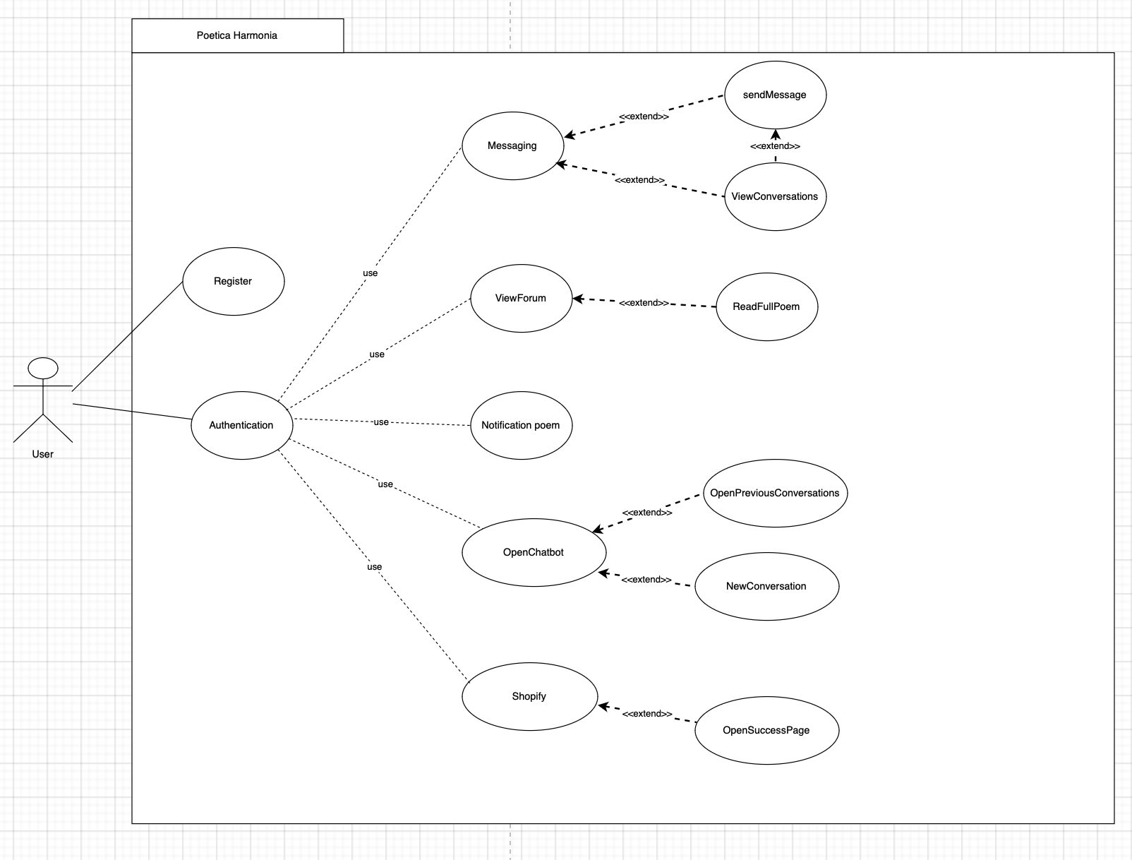
Application requirements
Messaging- allows user to communicate with members of community.
ViewForum- access to forum and search poems.
Notification Poem- alerts on wearable of poem of the day.
Open Chatbot- use case for ai use with extend elements to see previous communications or open new ones.

Slide 8
Design details
Minimalistic approach;
Contrasting colors increases accessibility;
Options limited for efficient use;
F design layout.

Slide 9
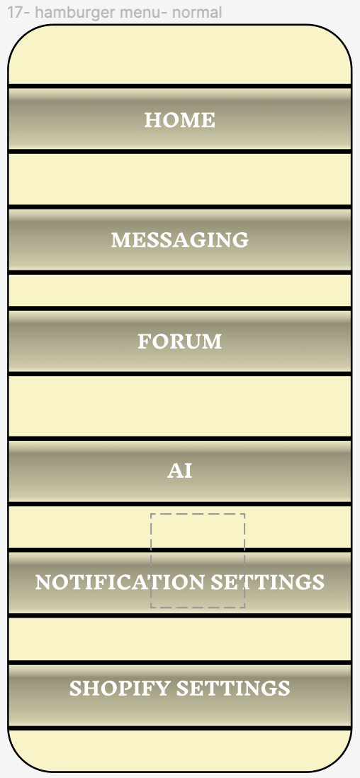
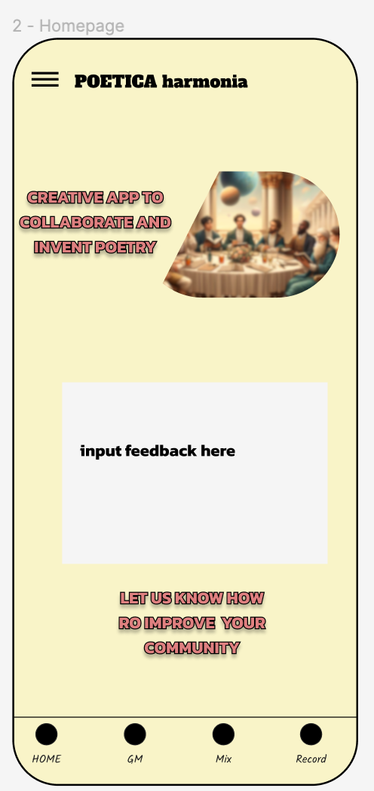
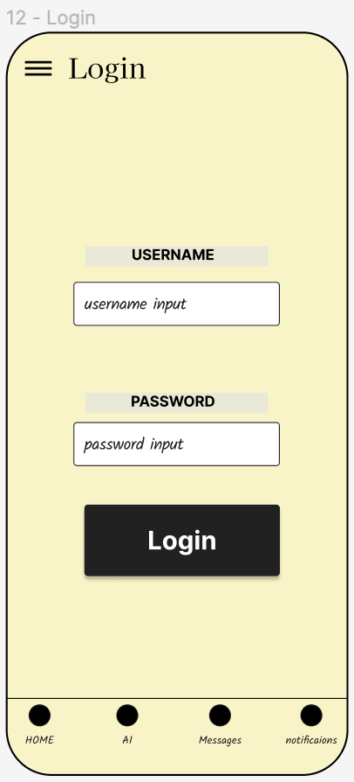
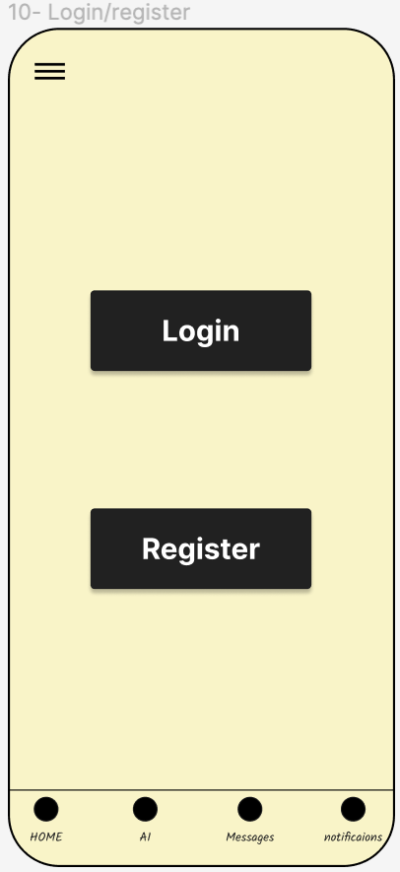
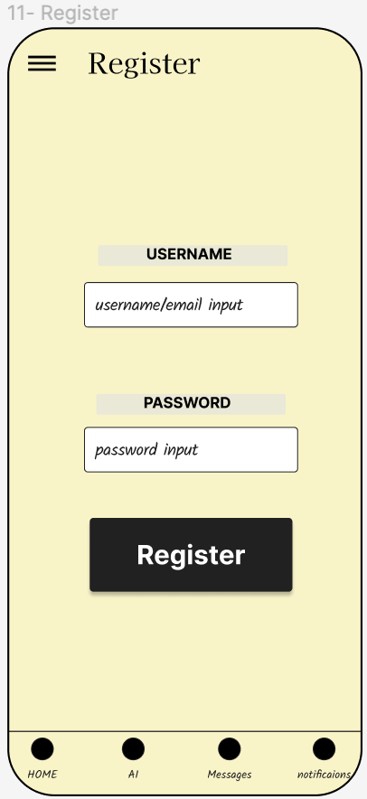
Design- authentication
This menu shows all features of the app.
Homepage has information about the app.
Login page to be used once while accessing app.
Initial set up page.
Initial registration page which takes you back to setup.

Slide 10
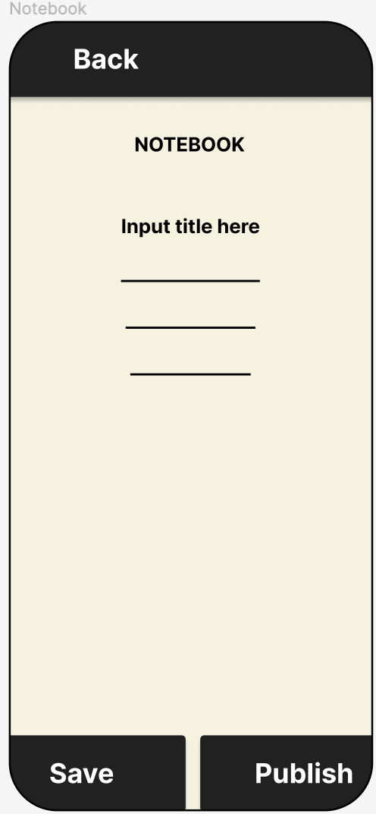
Design- Poem Writing
This will be where most of the work is done.
Creating poems in a notebook which will be saved as such
Due to the minimalistic approach, there are three buttons: back, save(if don’t want to publish) and publish.
Notebook is accessible from homepage.

Slide 11
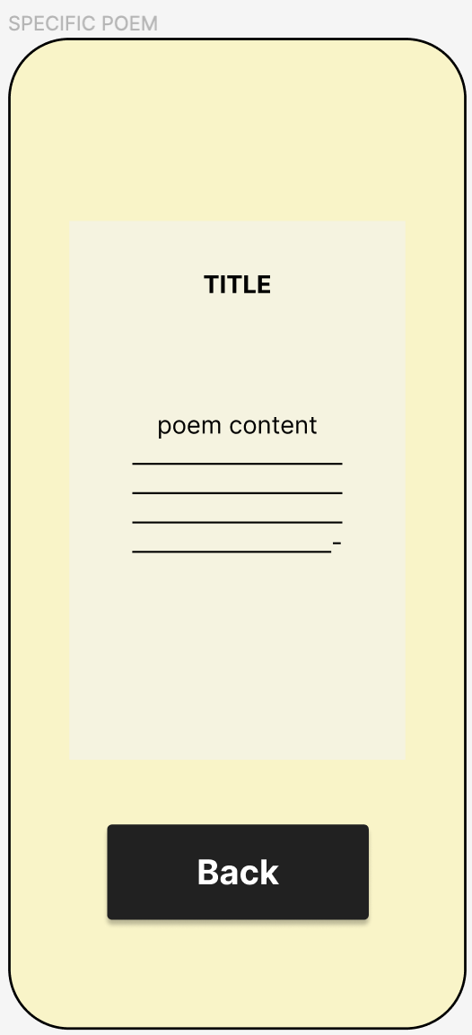
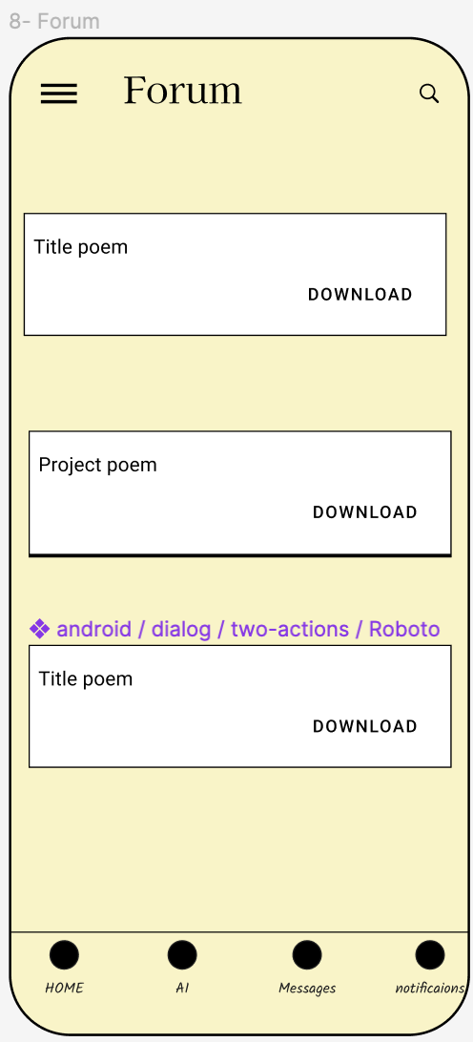
Design- Forum
A straightforward layout.
Forum has posts which can be accessed by clicking.
A popup window is shown and it only has a back button after read.
There is a download function for personal use.

Slide 12
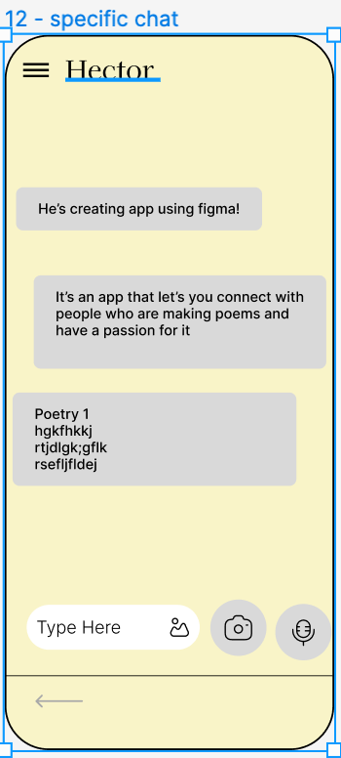
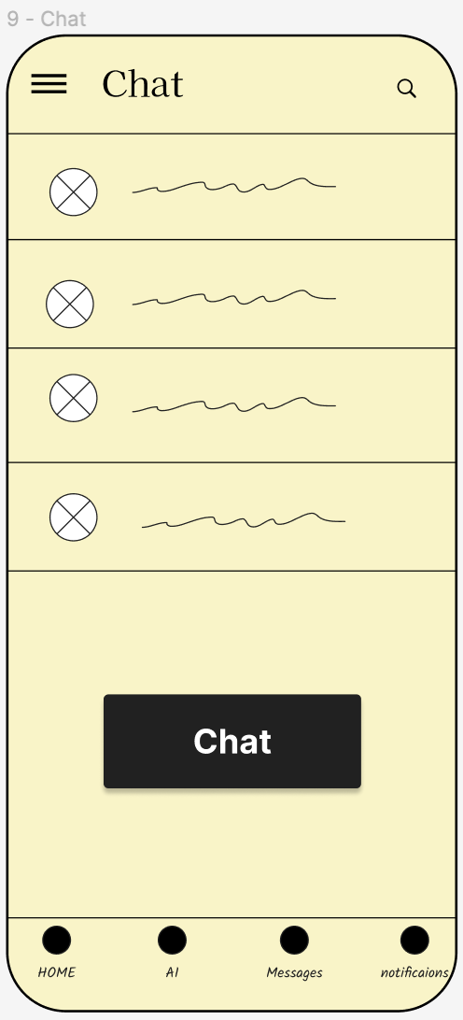
Design- messaging
One to one messaging is done through the chat page where you can access previous chats or create a new one by clicking the button.
Clicking the specific individual you can access the personal chat page.

Slide 13
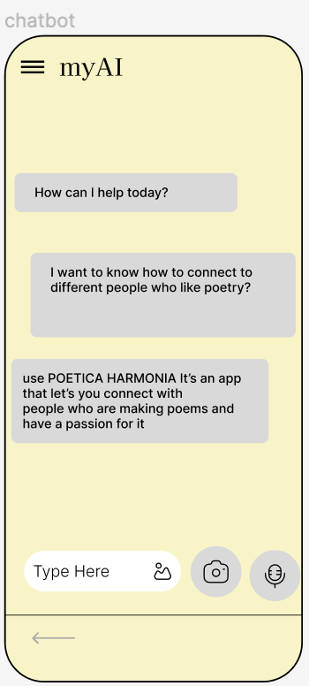
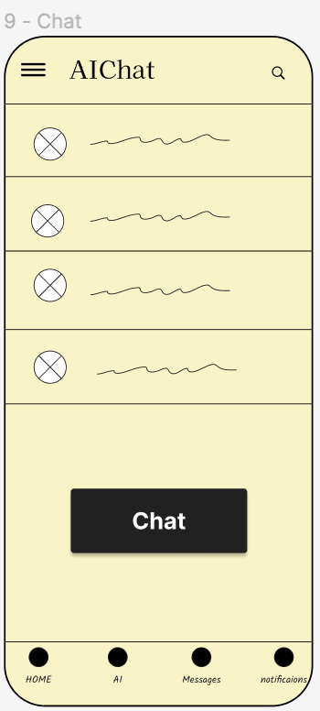
Design- AI Chatbot
AIChat stores all previous chats where you can access them or create a new one by clicking the button.
Clicking the chat button, you can prompt the myAi for responses.

Slide 14
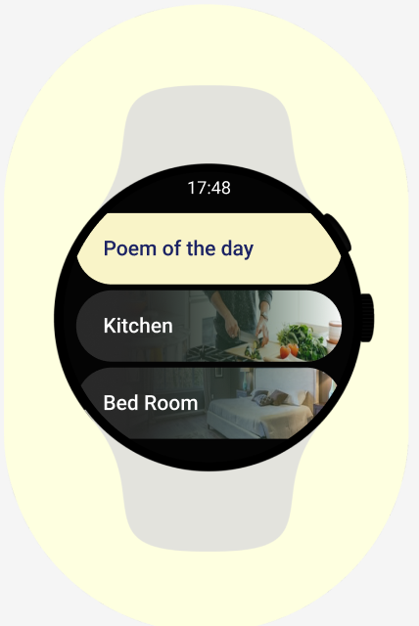
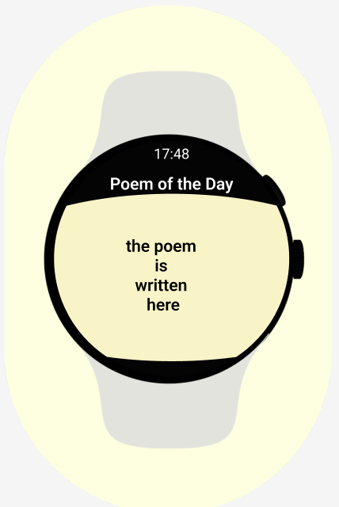
Design wearable- notifications
An alert is given of a new notification daily and it shows poem of the day as disply.
By clicking the notification you can get a detailed context of the poem and the poem itself.

Slide 15
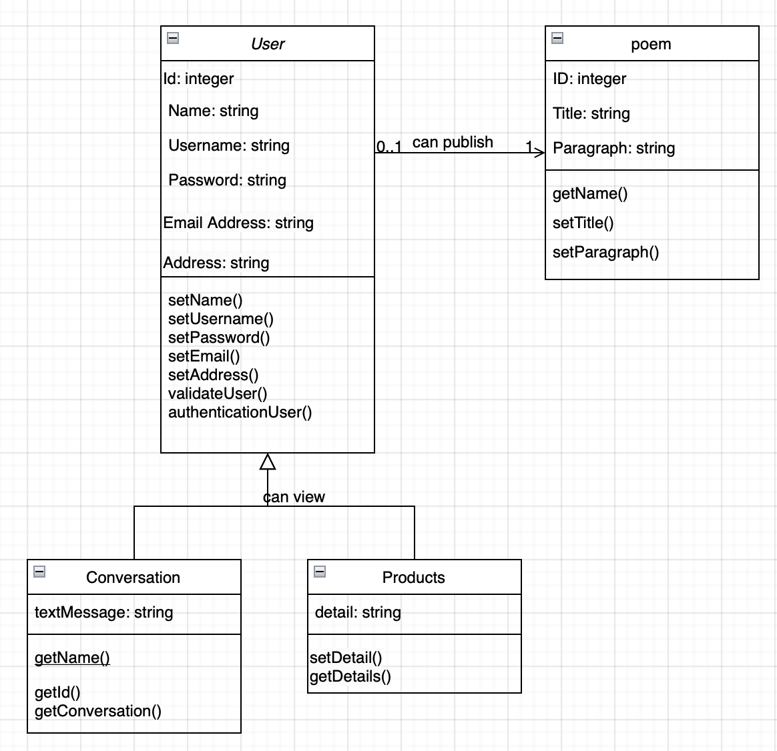
Relationships- Class diagrams
The class diagram has been given a simplistic approach as to not overcomplicate the app.
All classes are connected to user as the superclass.
Separate classes for different conversations are not made as same class will be adapted to different features.

Slide 16
SQLite
Advantages
Disadvantages
Previous experience using this software;
Easy to set up, use and maintained;
Suitable for small projects;
Free and open source;
Transaction support, allowing to group multiple operations into one category.
Limited capabilities only suitable for small projects and medium level projects;
No client-server architecture;
It is not scalable as it compromises performance with high sets of data.

Slide 17
Firebase
Advantages
Disadvantages
Cloud-based database;
Owned by Google therefore reliable;
Authentication services;
ML services;
Storage for all types of content;
Easy to learn.
It is a freemium, where some features come at a cost;
Limited database control;
Compliancy- GDPR Rules are effective.

Slide 18
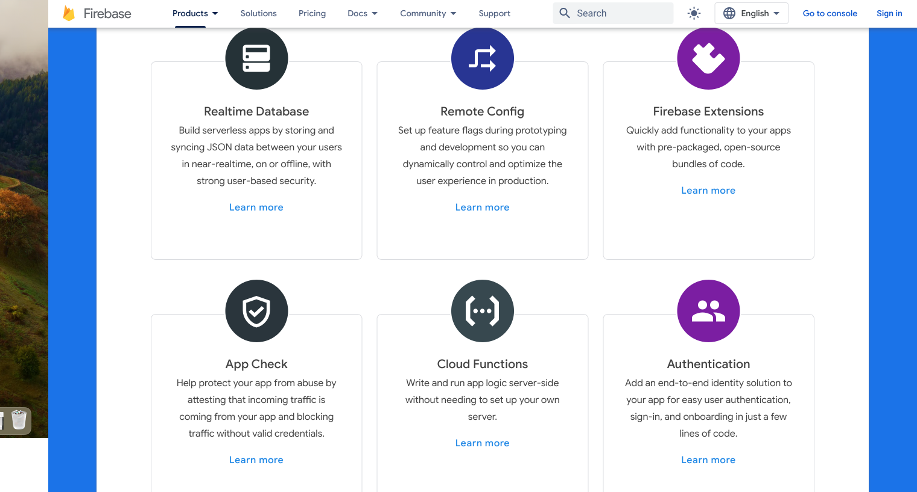
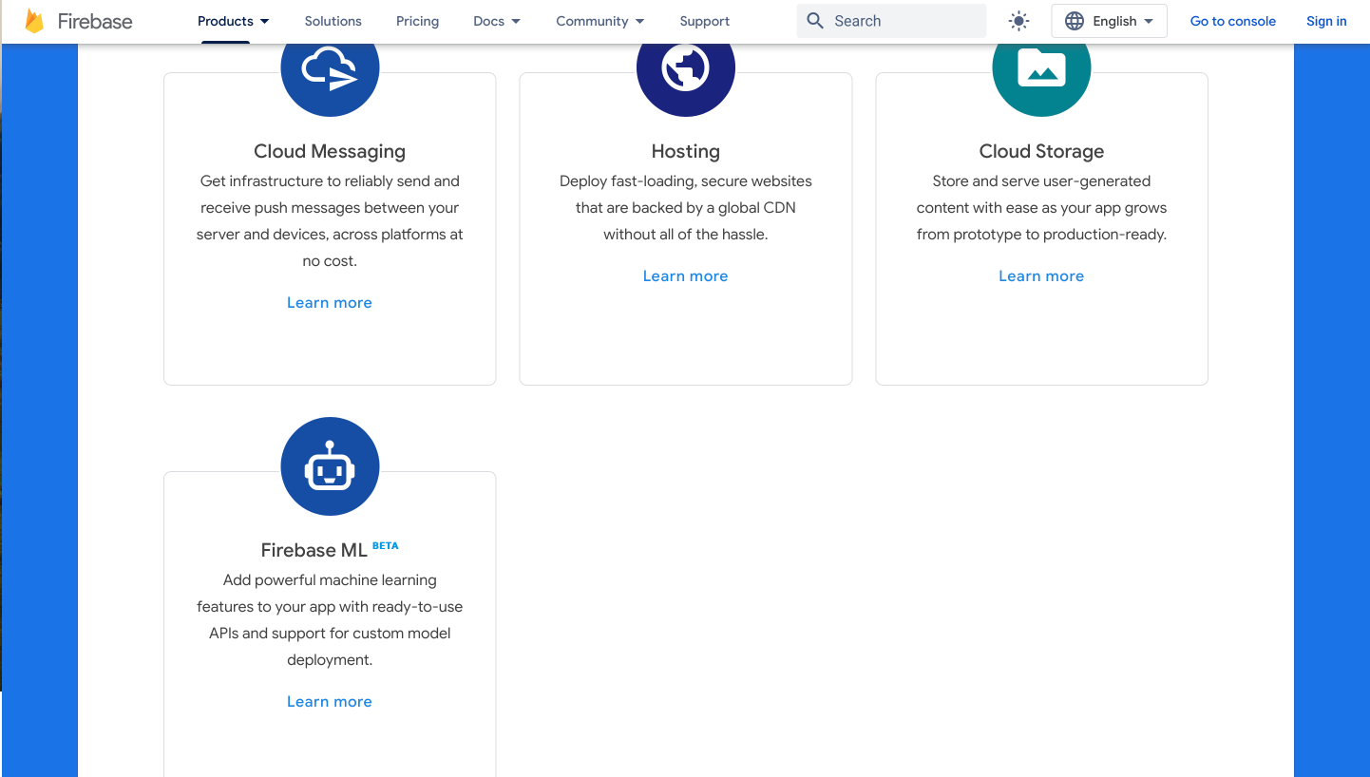
Data persistence – Firebase
Firebase is going to used due to it being efficient and also ethically a better option.
Firebase has more features shown in the screenshots presented on the side which include ML and authentication.
The users will need to authenticate themselves through login systems which can be easily integrated using Firebase. Also, firebase allows cloud messaging which can be used for the 1-1 messaging feature.
Also, due to it being a cloud based real-time database the performance will not be affected hence it will be quick to use.

Slide 19
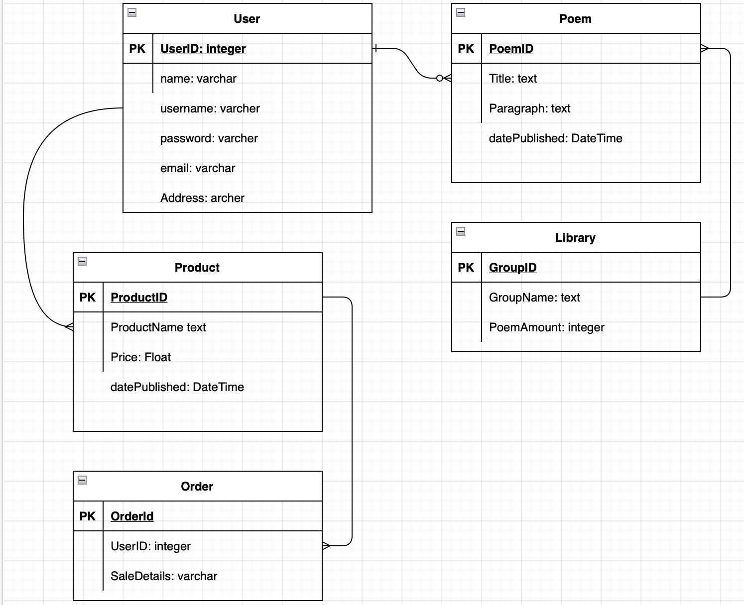
Data persistence- E-R diagrams User contains the specified attributes (see diagram). One user can have many poems and many products. Many poems can be in a group but the group cannot have duplicate poems. A product can have many orders, however one user can have made that specific product.

Slide 20
Frameworks
Description | hyperlink
Shopify integration API documents | https://shopify.dev/docs/api
Wearable notification and alert API from android. | https://developer.android.com/develop/ui/views/notifications/build-notification
Poetry database(poetry db) | https://rapidapi.com/thundercomb/api/poetry-db/
Poetry database(EmotionalPoem) | https://rapidapi.com/keydepth/api/emotional-poem

Slide 21
Frameworks (AI documentation)
AI Name | hyperlink
ChatGPT chatbot documentation | https://rapidapi.com/nextbaseapp/api/chatgpt-gpt4-ai-chatbot/
OpenAI | https://rapidapi.com/rphrp1985/api/open-ai21
Copilot | https://rapidapi.com/letscrape-6bRBa3QguO5/api/copilot5/

Slide 22
REFERENCES
Poetry (2024) Encyclopædia Britannica. Available at: https://www.britannica.com/art/poetry (Accessed: 14 March 2024).
Jung, C.G., 1966. On the relation of analytical psychology to poetry. The Critical Tradition: Classic Texts and Contemporary Trends, pp.544-53.
Iyengar, S. (2023) New survey reports size of poetry’s audience – streaming included, National Endowment for the Arts. Available at: https://www.arts.gov/stories/blog/2023/new-survey-reports-size-poetrys-audience-streaming-included#:~:text=According%20to%20the%202022%20survey,the%202012%20and%202008%20levels. (Accessed: 14 March 2024).
Curcic, D. (2023) Poetry Sales Statistics, WordsRated. Available at: https://wordsrated.com/poetry-book-sales-statistics/#:~:text=14.5%25%20of%20women%20stated%20that,to%20read%20poetry%20than%20men. (Accessed: 14 March 2024).
Firebase Products (no date) Google. Available at: https://firebase.google.com/products-build (Accessed: 14 March 2024).

